Slide 1
Welcome to CompSci 190: Foundations of Data Science
Jeff Forbes
August 27, 2018
Sit in the first five rows!

Slide 2
Plan For The Day (PFTD)
Be able to articulate whether FoDS is the right course for you, in terms of being able to complete it with understanding
Be able to describe what data science is and what the implications are of the work of data scientists
Be able to explain what work is expected: in-class team work, homework, projects, and exams

Slide 3
Acknowledgements
Adaption of Data 8
Ani Adhikari, John DeNero, and David Wagner + a lot of staff at the University of California, Berkeley.
Materials used with permission
NAS Report on Envisioning the Data Science Discipline
Slides from Data Science in the 21st Century at CRA Snowbird 2016
Thanks to Mine Cetinkaya-Rundel, Kristin Stephens-Martinez, Max Bartlett, & Jose San-Martin

Slide 4
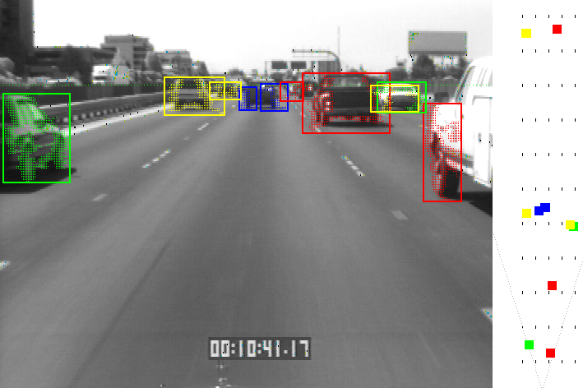
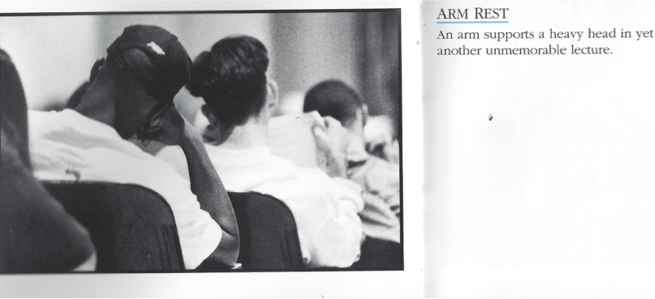
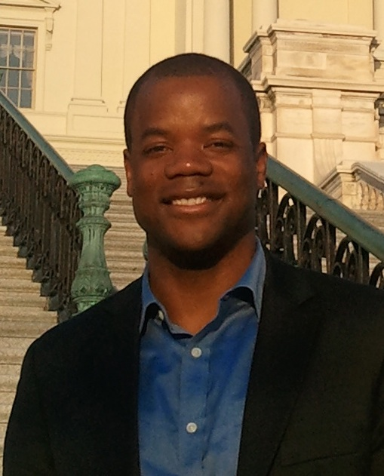
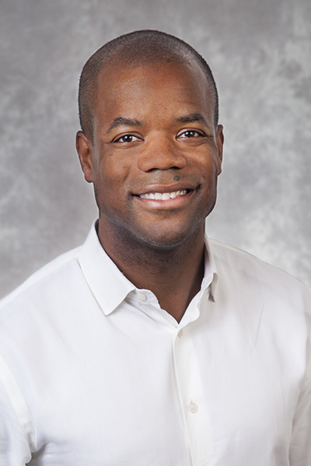
Who am I?
Who are you?
http://bit.ly/FoDS-f18-0827-0
Notes:
Talk about who I am in preparation for knowing who they are

Slide 5
What is Data Science?
From the ACM Taskforce on Data Science Curricula
Draws from many different disciplines

Slide 6
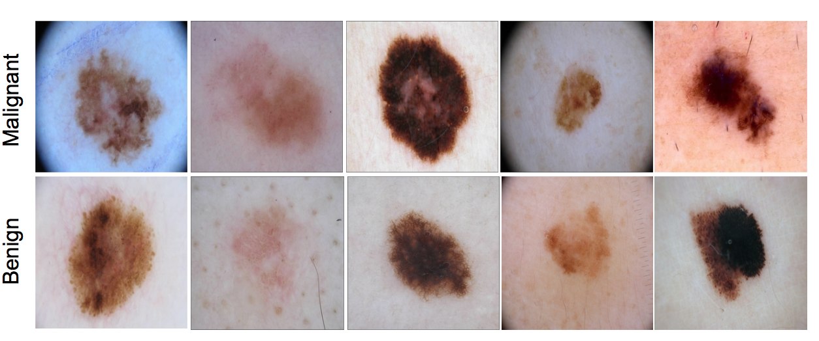
Applications of Data Science
Medicine: Melanoma detection
[Codella et al 2017]
Business:
Smart Cities:
What applications of data science interest you?
http://bit.ly/FoDS-f18-0827-1

Slide 7
What does a data scientist do?
From Peter Skomoroch
The Best Job in America for the past three years?
A global shortage in data scientists?
Lots of buzz and buzzwords?

Slide 8
Ethical & Social Implications of Data
Fairness
Consider equity and avoid bias that may be inherent in data sets
Example: Sentencing practices for criminal justice
Validity
Data set should contain accurate and relevant information. Context matters!
Example: Survivor bias in analyzing STEM degree production
Data confidence
Don’t draw stronger-than-appropriate conclusions
Example: Stock market predictions
Privacy
Must be good stewards of data
Consider how data is collected and analyzed

Slide 9
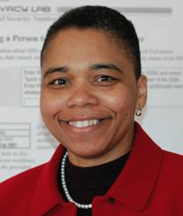
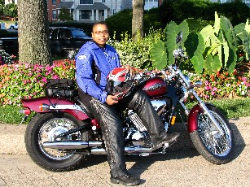
Latanya Sweeney
Prof. Government and Technology @ Harvard
Former CTO of the FTC
I am a computer scientist with a long history of weaving technology and policy together to remove stakeholder barriers to technology adoption. My focus is on "computational policy" and I term myself a "computer (cross) policy" scientist. I have enjoyed success at creating technology that weaves with policy to resolve real-world technology-privacy clashes.
http://latanyasweeney.org/
k-Anonymity: each subject cannot be distinguished from at least k-1 others
Identify 87% of US population using (dob,zip,gender).

Slide 10
What is Foundations of Data Science?
Drawing useful conclusions from data using computation
Exploration
Identifying patterns in information
Uses visualizations
Inference
Quantifying whether those patterns are reliable
Uses randomization
Prediction
Making informed guesses
Uses machine learning

Slide 11
Course Details
https://www.cs.duke.edu/courses/compsci190/fall18/
Mondays: Active Lecture
Wednesdays: Team-Based Learning in Lab
Midterm Exams: 10/3 & 11/28
Weekly Homework: Discuss with your team but submit individually
3 Projects: Work in pairs
Final Project: Work in pairs – Present on 12/16

Slide 12
Team-Based Learning
Why?
Facilitate collaboration
Problem solving accompanied by group interaction promotes learning
Do reading outside of class
Readiness Assurance
Individual
Team
Application-focused Exercise
Beginning of Semester (8/28): Survey & team assignment
End of Semester: Peer Evaluation

Slide 13
How will you learn?
Learn by doing
Learn computing concepts by doing interesting things on data
Learn statistical concepts by observing what’s interesting
Learn domain knowledge just in time
Minimal setup: Jupyter Notebooks (https://jupyterhub.cs.duke.edu)

Slide 14
Is FoDS the right course for you?
Yes if:
You’re interested in gaining quantitative (QS) or computational skills.
You want to understand and develop points of view based on the analysis of data as well as evaluatearguments made by others
Probably not if:
You’ve already taken a number of computer science and statistics courses. CompSci 216 – Everything Data may be more appropriate?
You’ve already taken Stat 199
Want a course that satisfies an elective requirement for Stats or CompSci
Ask me!

Slide 15
What’s next?
Review Chapter 1 of Computational and Inferential Thinking
Complete the team-maker survey (Will be published to website)
Tell a friend
There’s still space!

